Slide 1
Group Project Mid-Point Presentation
dotNetwork - Social Network for coders
Ben Bowes
Andrew Norman Spencer Newton

Slide 2
What we’ve done so far
UML- Complete (needs updating)
Databases (Via Entity Framework)- Completed
Database Layer + Tests – Complete
Logic layer + Tests – Nearly Completed
WPF – Completed
ASP- In Progress

Slide 4
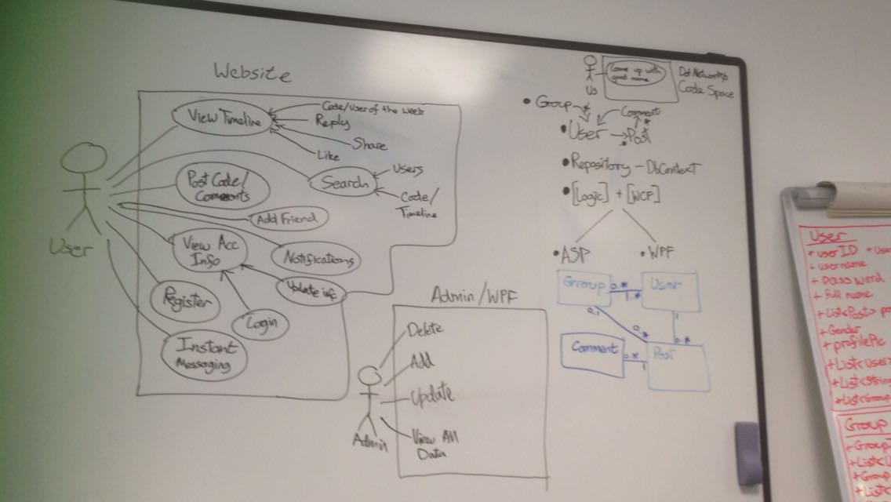

Slide 5
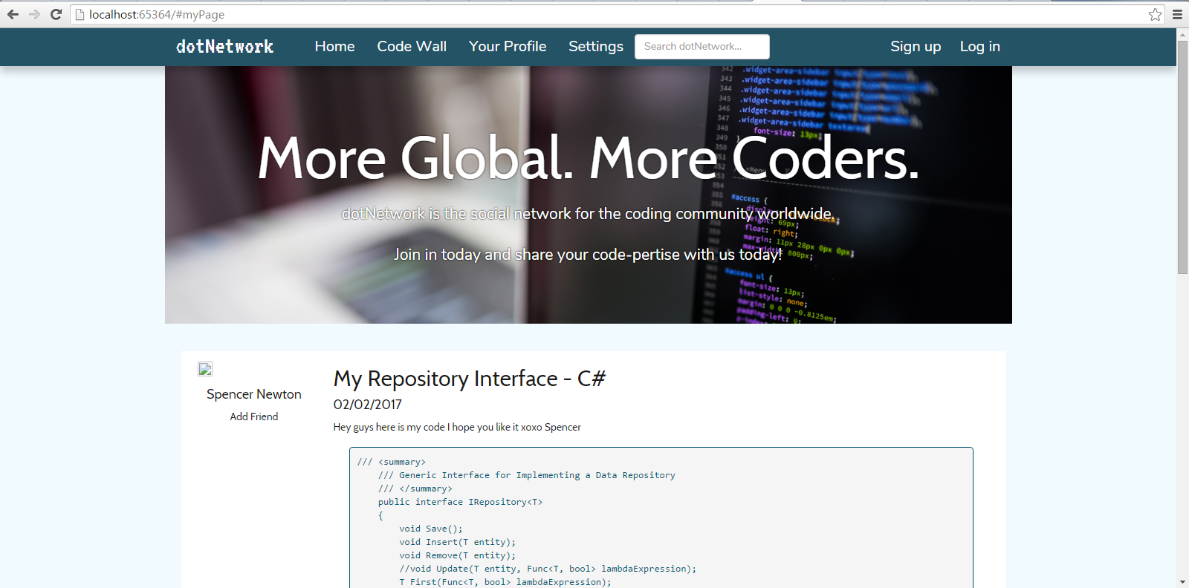
Application so far…

Slide 6
Challenges we’ve faced
Using SVN as a Group (Commit + Update conflicts and Committing Build Errors)
Many-to-many entity relationships on the DB
Tube Strikes
Flu Outbreak

Slide 7
What’s left to do
Complete the ASP.NET Application
Database Access – Make it Asynchronous
TDD
Achieve 75%+ Code Coverage
Innovate new features when all currently planned features are fully implemented.

Slide 8
Now for the code…

